Slide 1
Evaluating Performance
HCA 343
Juliana C. Hawkins, MHA, CPC

Slide 2
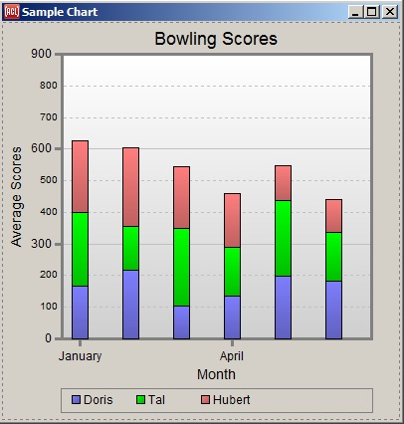
Assessment
Judging or evaluating measurement data for the purpose of reaching a conclusion
Judge the bowling score data. Any conclusions?
Notes:
Some conclusions:
All scores varying someone each month.
Hubert seems to have the most consistent score each month.
January was the best month for everyone.

Slide 3
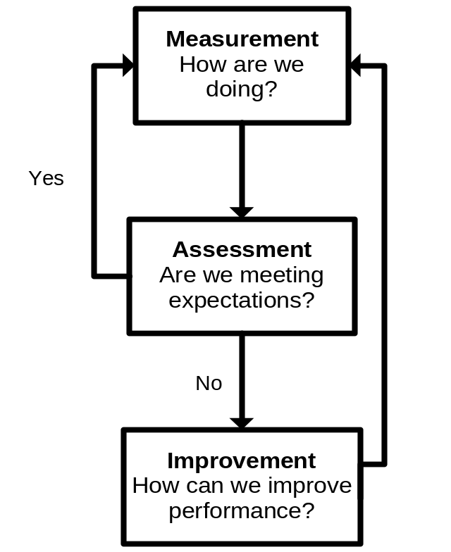
The Assessment Step
Measurement results are evaluated to determine whether processes are performing as expected.
Measurement results are also assessed to judge the impact of improvements.

Slide 4
Assessment Activities
Display measurement data
Compare performance to expectations
Determine whether action is needed

Slide 5
Display Measurement Data
Factors to consider:
  Type of data to be reported
  Audience for the data
  Intended use of the information

Slide 6
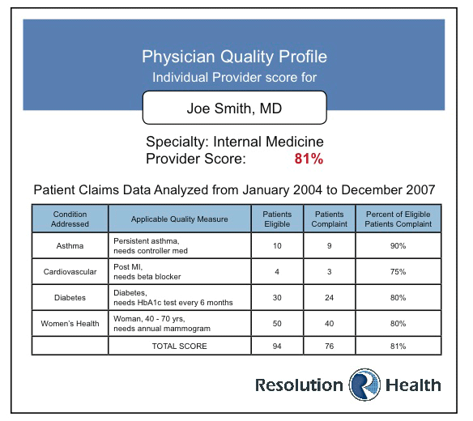
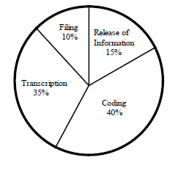
Snapshot Reports
Display data from one period
Tabular Report
Pie Chart

Slide 7
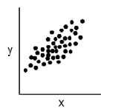
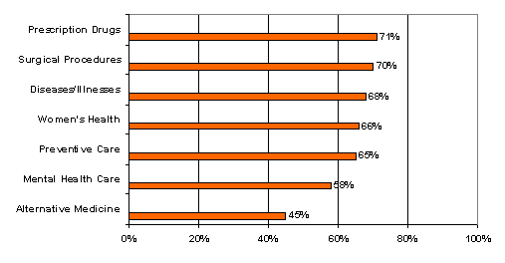
Snapshot Reports
Scatter Diagram
Bar Graph

Slide 8
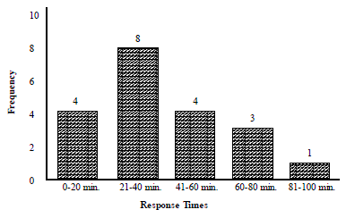
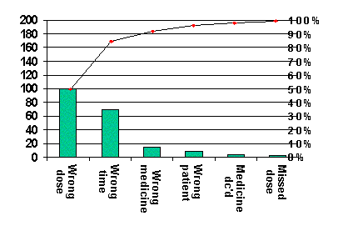
Snapshot Reports
Histogram
Pareto Chart

Slide 9
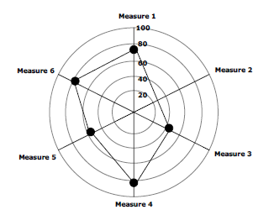
Snapshot Reports
Radar Chart

Slide 10
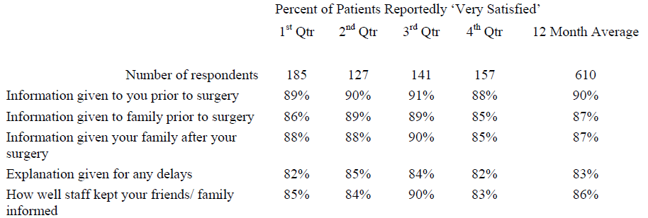
Trend Reports
Display data from several time periods
Tabular Report

Slide 11
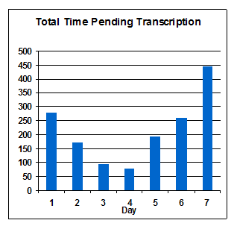
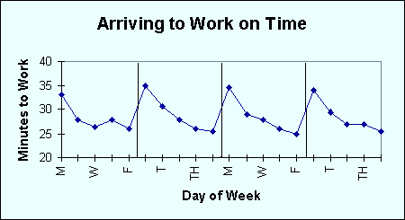
Trend Reports
Line Graph
Bar Graph

Slide 12
Compare Performance to Expectations
Establish performance expectations
  Consider “absolutes” found in external regulations and accreditation standards.
  No external expectations? Set performance targets on the basis of
    opinion,
    criteria, or
    performance comparisons.

Slide 13
Statistical Process Control (SPC)
Application of statistical methods to assess and control performance
  Used to identify performance variations that would benefit from further investigation
  Understanding variation is the first step toward improvement

Slide 14

Walter A. Shewhart
(Early 1920s, Bell Laboratories)
Some process variation is due to common causes.
Some process variation is due to special causes.
      Shewhart championed the use of statistical methods to evaluate the causes of variation in performance results. Improvement strategies are affected by the cause of variation.

Slide 15
Improving a Process
Process is stable (only common-cause variation is present).
  To reduce variation and improve performance, process changes must be made (common causes are inherent in the process).

Slide 16
Improving a Process
Process is unstable (special-cause variation is present).
  Special causes are identified and eliminated.
  Process itself is not changed (special causes are extrinsic to the process).

Slide 17
SPC Tools
Used to identify the type of variation exhibited by performance data
  Line graphs
  Control charts

Slide 18
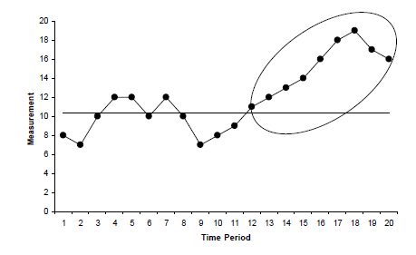
Line Graph
Long run: Significant performance trend that should be investigated

Slide 19
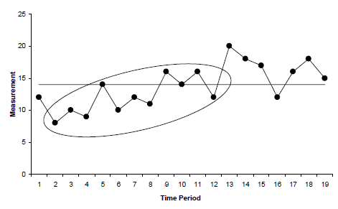
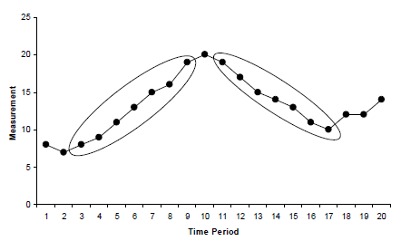
Zigzag pattern
Consistent increase or decrease

Slide 20
Control Chart
Dr. Walter Shewhart developed the control chart to identify types of variation.
Control charts have statistically calculated upper and lower control limits.
  Usually set at +3 and –3 standard deviations from the mean

Slide 21
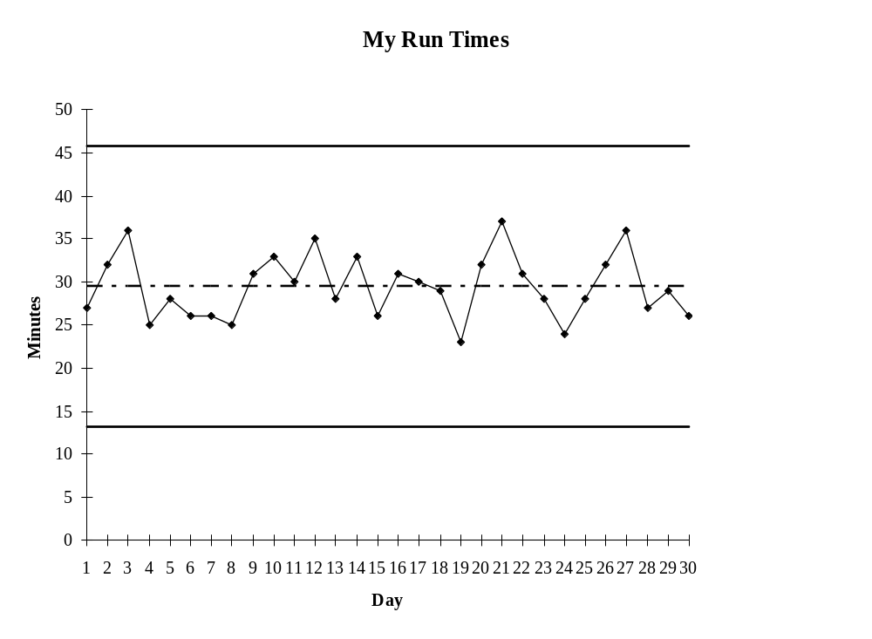
Control Chart Example
Upper control limit
Mean (center line)
Lower control limit

Slide 22
Rationale for Control Limits
Do not want an undue number of false alarms
Do not want to detect each little change in the process
Notes:
Excessive number of false alarms would undermine your credibility and discredit the technique.
The method is to limit the variability, so when an observation is found outside the limits, looking for an assignable cause is worthwhile.

Slide 23
Average Wait Time to See Doctor in Emergency Department
120
100
Upper control limit
Mean
80
Lower control limit
Min.
60
40
20
0
Consecutive Weeks
Investigate and correct special-cause variations when they occur.

Slide 24
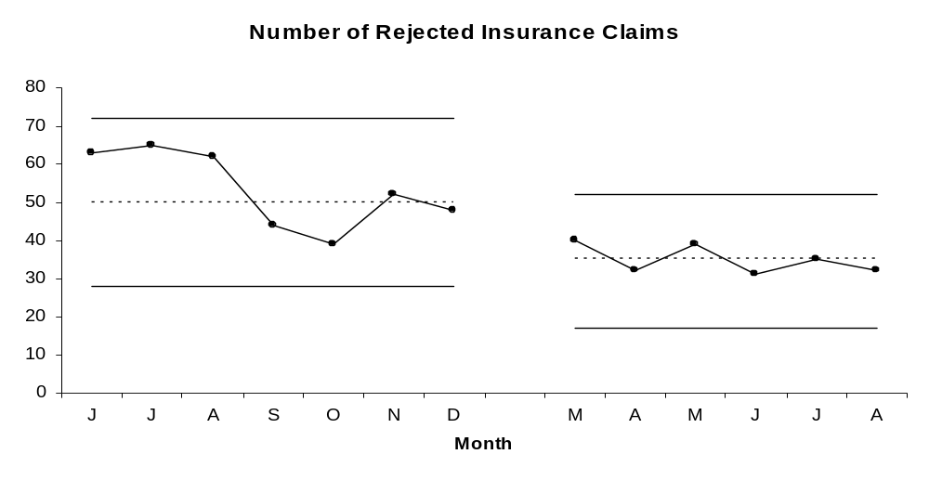
Number of Rejected Insurance Claims
Process changes made
When performance is stable (no special-cause variation), process changes are made to improve performance and reduce common-cause variation.

Slide 25
Signals of Need to Improve
Performance does not meet expectations; there are no signs of special-cause variation.
Performance meets expectations; there are signs of special-cause variation.
Performance does not meet expectations; there are signs of special-cause variation.

Slide 26
3. Determine Whether Action Is Needed
Performance assessment is the evaluation stage of quality management.
  Measurement data are reported and analyzed to determine whether improvement opportunities exist.

